Slide 1

IBM Coursera Advanced Data Science Capstone
Soundar Murugan

Slide 2
IoT Sensor Motion Detector
Use case:
Use machine learning to determine if a person is present in the room without the use of proximity sensors.
Training dataset:
Environmental Sensor Telemetry Data
https://www.kaggle.com/garystafford/environmental-sensor-data-132k

Slide 3
Solution to the use case
Use the Environmental Sensor Telemetry Data for model training and testing.
Create models:
Logistic Regressor
Gradient Boosted Trees Classifier
Deep Neural Network
Best results with Gradient Boosted Trees Classifier:
Accuracy: 88.16%
F1 Score: 0.876

Slide 4
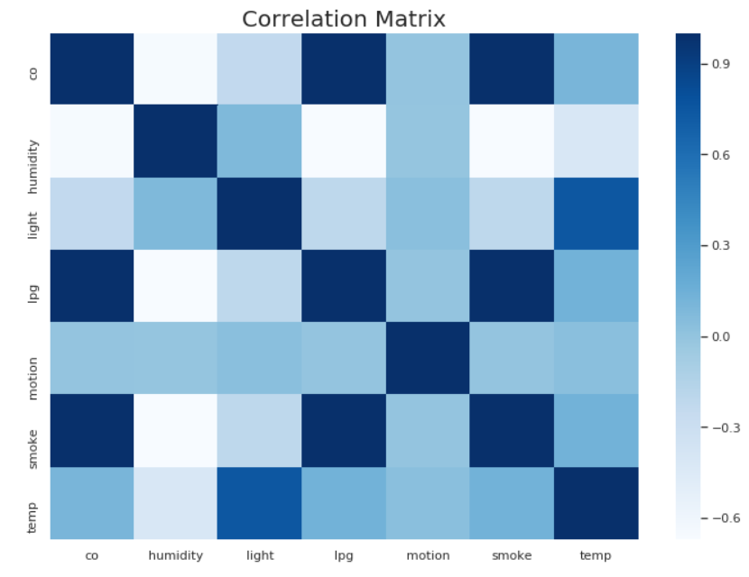
Initial Data Exploration
Dataset
405184 rows of IoT sensor data of three devices together and 9 columns
No missing values
Readings of 3 different IoT devices
Light sensor of one device faulty
Very few outliers

Slide 5
Architectural Choices
IBM Watson Studio
Apache Spark
Seaborn and Matplotlib
For Machine Learning classifiers:
SparkML
SciKit-Learn
For Deep Learning:
Keras
Tensorflow

Slide 6
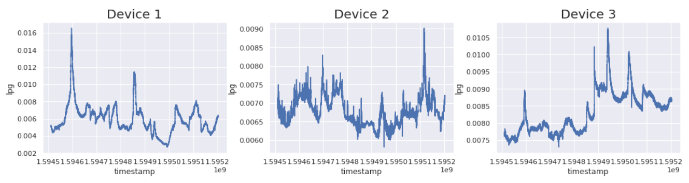
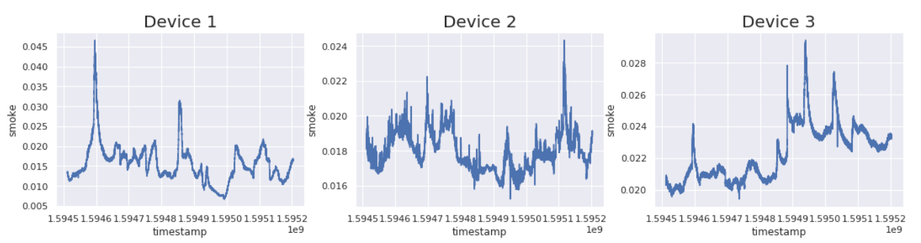
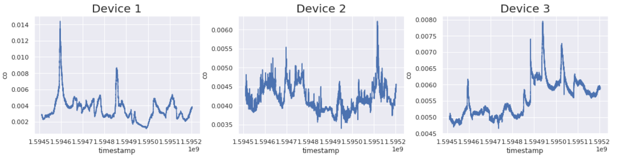
Data Cleaning
The graphs for:
Smoke vs Time
CO vs Time
LPG vs Time
Were very identical and hence, two of these features were discarded to eliminate redundancy.

Slide 7
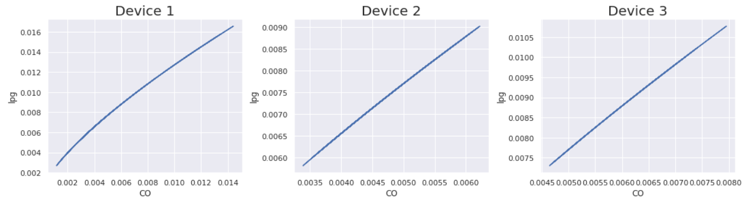
Data Cleaning
An example of LPG vs CO demonstrated extremely linear relation hence justifying the previously made decision.

Slide 8
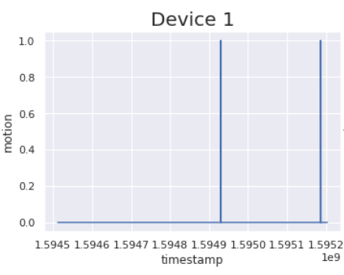
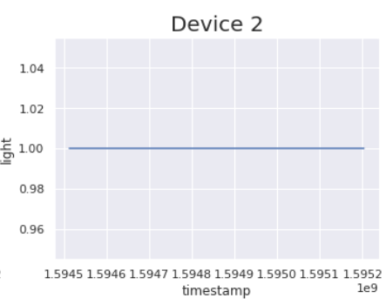
Data Cleaning
Further analysis found defects in:
Light sensor of Device 2
Motion sensor of Device 1
Hence, Device 3 was chosen exclusively for model training.

Slide 9
Model Evaluation
Model | Normalisation | Optimiser | Epochs | Accuracy | F1 Score
GBT | False | NA | NA | 0.88 | 0.87
 | True | NA | NA | 0.88 | 0.87
Logistic Regression | False | NA | NA | 0.52 | 0.0
 | True | NA | NA | 0.52 | 0.0
Neural Network | False | ADAM | 10 | 0.52 | 0.0
 | True | ADAM | 10 | 0.54 | 0.09

Slide 10
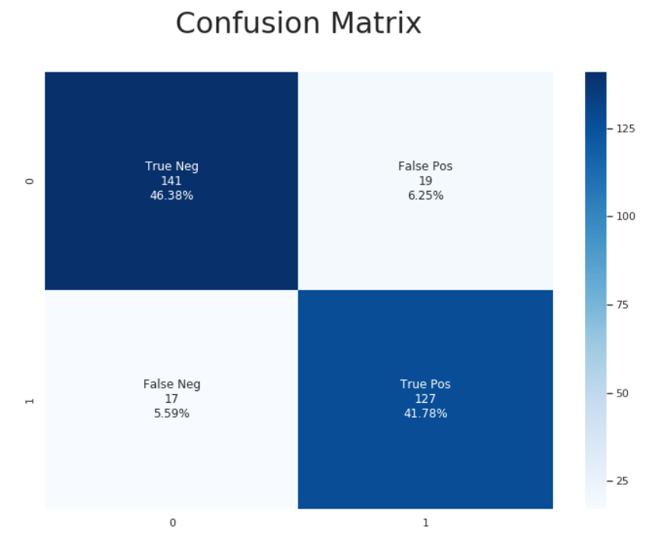
Summary
Since the GBT model had the highest accuracy and F1 score, it was used with test data and the adjacent confusion matrix was obtained.
When it comes to data normalization, there was not much of a performance difference obtained in this application, except for the neural network model.
The GitHub link for this project:
https://github.com/soundarzozm/Iot-Sensor-Motion-Predictor

Slide 11

Thank You!

